Slide 1
Operating System
18ESC108A Elements of Computer Science and Engineering
B. Tech. 2018
Ami Rai
Roopa G
Chaitra S
Department of Computer Science and Engineering
Faculty of Engineering and Technology
Ramaiah University of Applied Sciences

Slide 2
Objectives
At the end of this lecture, student will be able to
explain the nature and purpose of an operating system

Slide 3
Topics
Operating system
Services Provided by an OS
Examples

Slide 4
Operating System
Why do we need it?

Slide 5
Operating System
A place to run programs
Gives an interface to user
Manages hardware using “Drivers”
An Operating System (OS) is a program that acts an intermediary between the user of a computer and computer hardware
Example
DOS, Linux, Windows

Slide 6
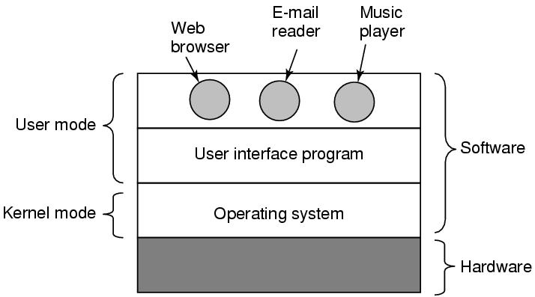
Where does the OS fit in?

Slide 7
Services Provided by an OS
Memory management
Allocating memory to running programs and deallocation
Processor management
Processing jobs, job scheduling
Device management
Deals with specific input and output units
File management
Deals with where the files are stores, their status and memory locations

Slide 8
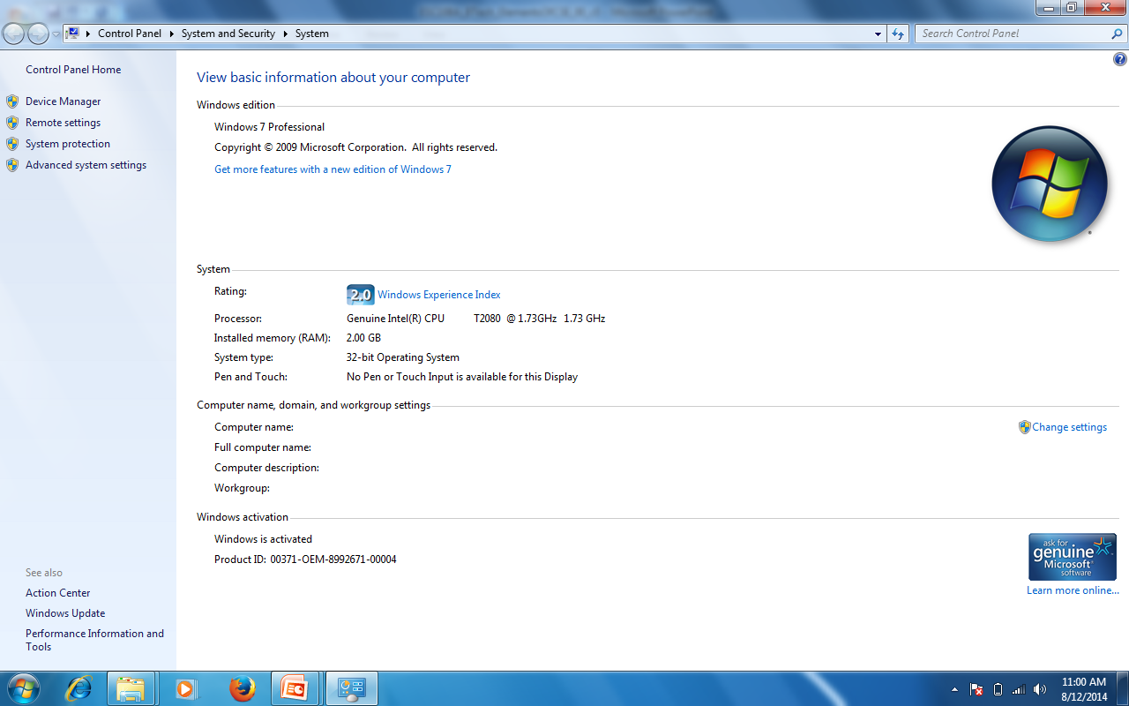
Operating System - Example

Slide 9
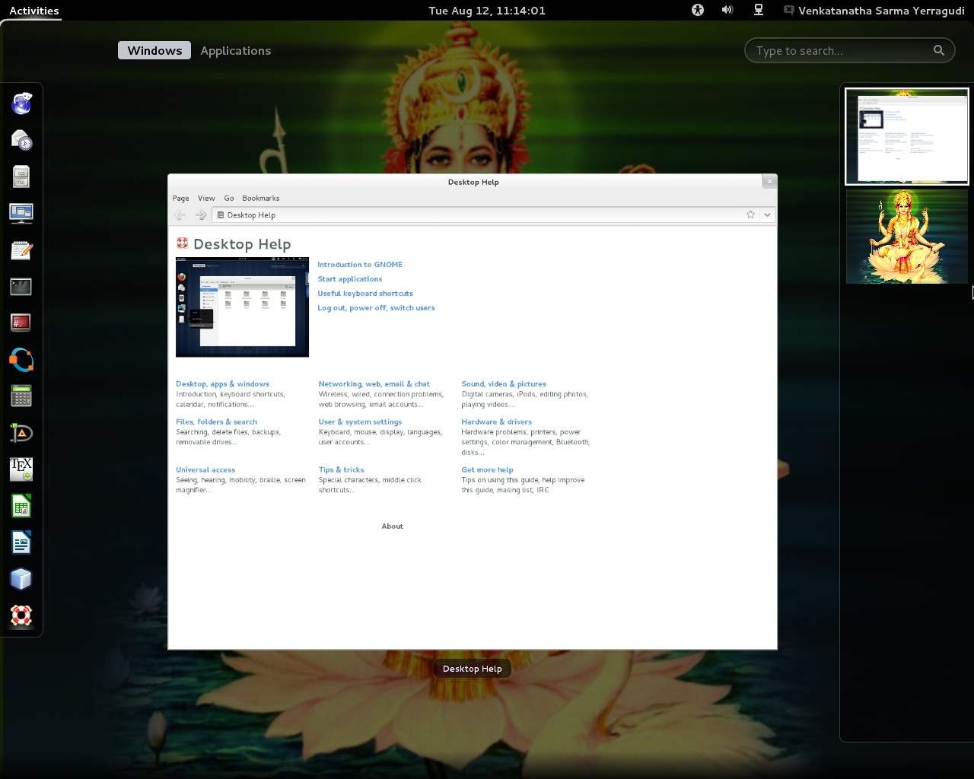
Operating System - Example

Slide 10
Summary
Operating System is a program that acts an intermediary between the user of a computer and computer hardware
The services provided by an OS are
Memory management
Processor management
Device management
File management

